Slide 1
SOCIAL MEDIA MARKETING

Slide 2
AGENDA
What is Social Media marketing?
Extended breakdown of Social Media marketing.
Creating a Social Media Strategy.
Example Use case.
Practical Implementation

Slide 3
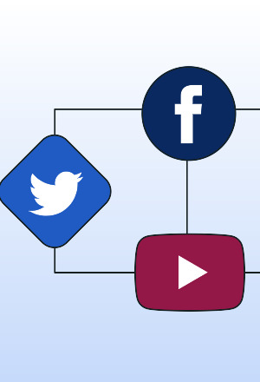
What is social media marketing?

Slide 4
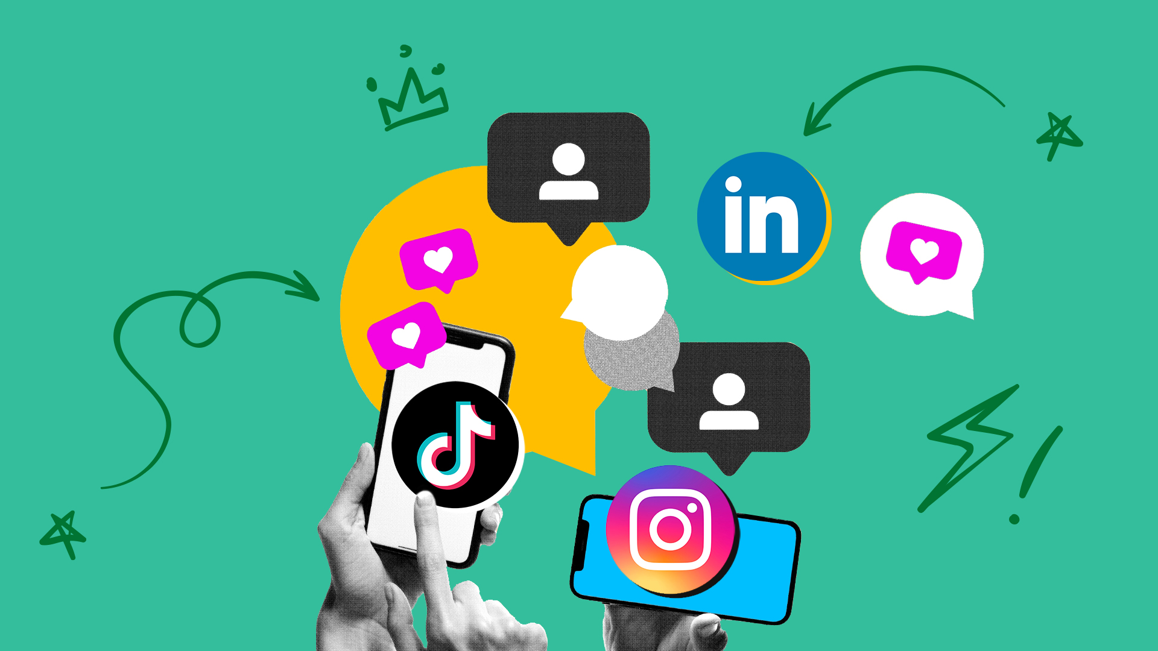

Social media marketing
SMM is the use of social media platforms to promote a product, service, or brand.
Goals: Build brand awareness, engage with audiences, drive traffic, and generate leads/sales.
Platforms: Instagram, Facebook, Twitter, LinkedIn, TikTok, Pinterest, etc.
It’s a subset of digital marketing focused on social interaction and community building.
Which SM platform would you use for what type of promotion?

Slide 5
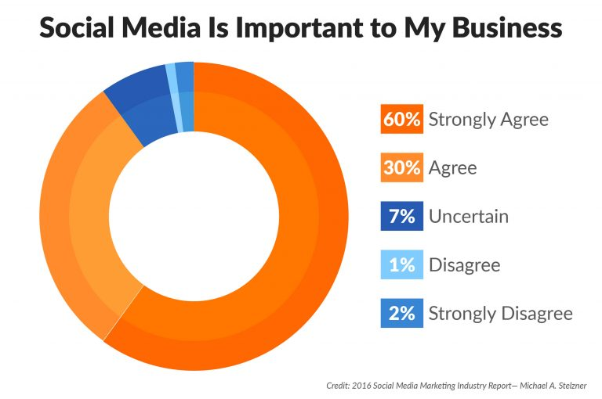
The Importance of SMM in Today’s Business World
Over 4.5 billion people use social media globally (as of 2023 data, likely higher now).
Direct access to target audiences: Millennials, Gen Z, and even older demographics are active.
Cost-effective compared to traditional advertising.
Enables two-way communication: Brands can listen, respond, and build relationships.
“80% of consumers are more likely to buy from a brand they follow on social media. Why do you think that is?”

Slide 6
Extended Breakdown of Social Media Marketing

Slide 7
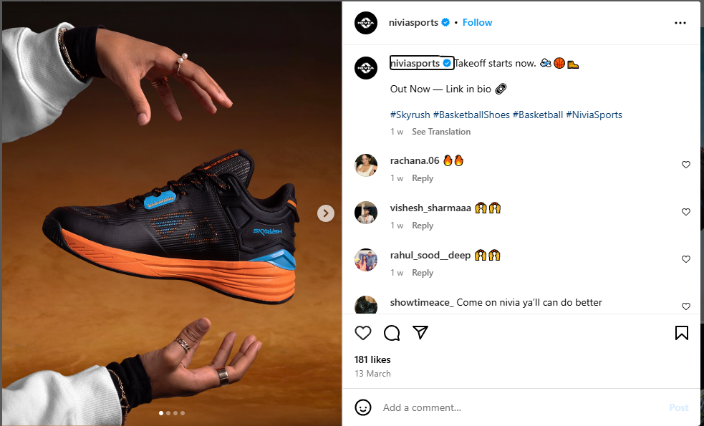
The components OF SOCIAL MEDIA MARKETING
Breaking Down SMM: Key Components
Content Creation: Posts, videos, stories, reels, etc., tailored to each platform.
Audience Engagement: Responding to comments, messages, and building a community.
Advertising: Paid ads (e.g., Instagram Ads, LinkedIn Sponsored Posts).
Analytics: Measuring performance (e.g., reach, engagement, conversions).
Influencer Marketing: Collaborating with influencers to expand reach.
What component of Social Media marketing is the below Post?

Slide 8
Organic vs. Paid SMM: What’s the Difference?
Paid: Sponsored ads,
boosted posts (e.g.,
Facebook Ads).
Pros: Targeted reach, measurable ROI.
Cons: Requires budget, can feel less authentic.
Organic: Free posts, stories, and engagement (e.g., sharing a blog post on Twitter).
Pros: Builds trust, cost-effective.
Cons: Limited reach due to algorithms.

Slide 9
Creating a social media strategy

Slide 10
Building a Winning Social Media Strategy
Set Goals
Brand Awareness
Know your audience
Choose Platforms
Create Content Plan
Monitor and adjust
Lead Generation
Customer Loyalty
Demographics
Interests
Behaviour
LinkedIn for B2B
Instagram for GenZ
Tiktok for GenZ
Types of post.
Frequency.
Tone of voice.
Analytics

Slide 11
Setting SMART Goals for SMM
Specific
Ex : “Increase Instagram Followers by 10%”
Measurable
Track progress with metrics (e.g: follower count, clicks)
Achievable
Realistic based on resources/ time.
Relevant
Time Bound
Align With Business Objectives
Set a deadline.

Slide 12
Setting SMART Goals for SMM
Specific | Measurable | Achievable | Relevant | Time-Bound
Grow website traffic from Instagram | By 15% (via analytics) | Yes, with 3 weekly posts | Ties to business growth | In 2 months
Design Smart Goals for “SJCIT” coffee shop’s social media.

Slide 13
USE CASE
GrameenKonnect Incredible India campaign

Slide 14
Thank you

